Slide 1
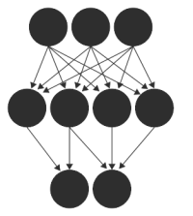






Deep Learning
Abdallah Musmar

Slide 2





Abdallah Musmar
PhD Candidate at USF – Information Systems and Decision Sciences
Manager in a Machine Learning team at PricewaterhouseCoopers
Managing the technical aspects of the Citizen Data Science program at USF
Experience
About 9 years in Data Science
Skills
Machine Learning, Python, and Basketball
Education:
PhD in Information Systems – USF
Master of Information Systems Management – Carnegie Mellon University
BSc Computer Engineering

Slide 3
Input X
Output Ŷ
.
.
.
.
.
.
.
.
.
.
.
.
.
.
.
.
.
.
.
.
.
.
.
.
.
.
.
.
.
.
.
.
.
.
.
.
.
.
.
.
Output activation f(n)
1 value: Logistic Regression
Multiple values :Softmax

Slide 4
What happens inside?
Initialize weights and bias for the network (W, b) and assign an activation function (example: ReLU, tanh, sigmoid)
Loop ~1000 times
Estimate y using: (a)Forward propagation and (b)cost function ->optimization algorithm example: gradient descent
Calculate dW,db, and other derivatives for every layer
Update the node values: W= W-αdW … same for others
Iterate until loss of cost function reaches its minimum

Slide 5
What can you do with Deep Learning?

Slide 6
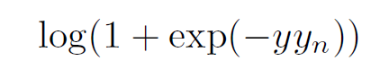
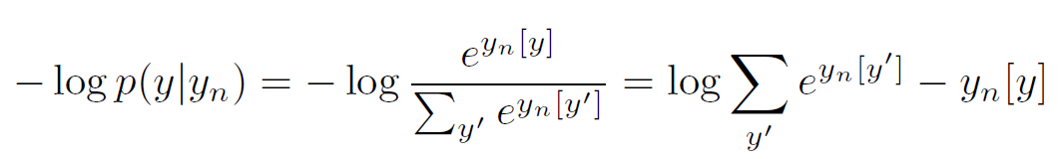
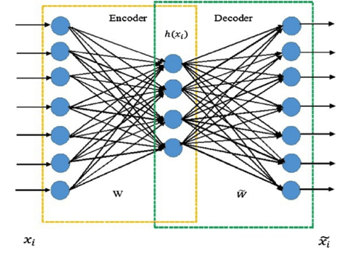
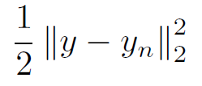
More about cost functions
Binary classification – using Binary exponential model
Multiclass classification (softmax) – using Multinomial exponential model
Regression – using Least mean squares (example: stock market prediction)
Recommendations and rating (like Netflix)
You can do a lot of other things, example: Autoencoders!
Regress from an observation to itself (Yn = X1)
Special Case: PCA

Slide 7
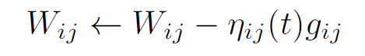
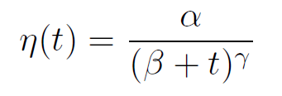
Optimization
Update weight and bias parameters with a rate of decay
Polynomial Decay: Learning rate alpha α
Minibatch
Adaptive Gradient
Momentum

Slide 8
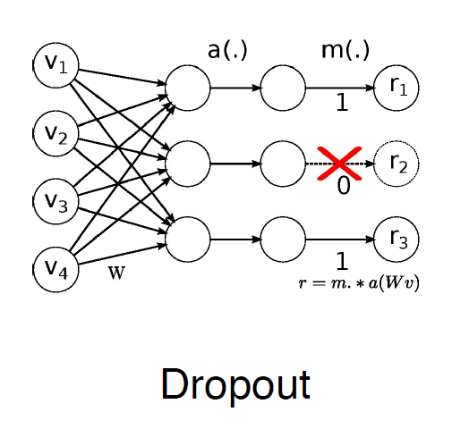
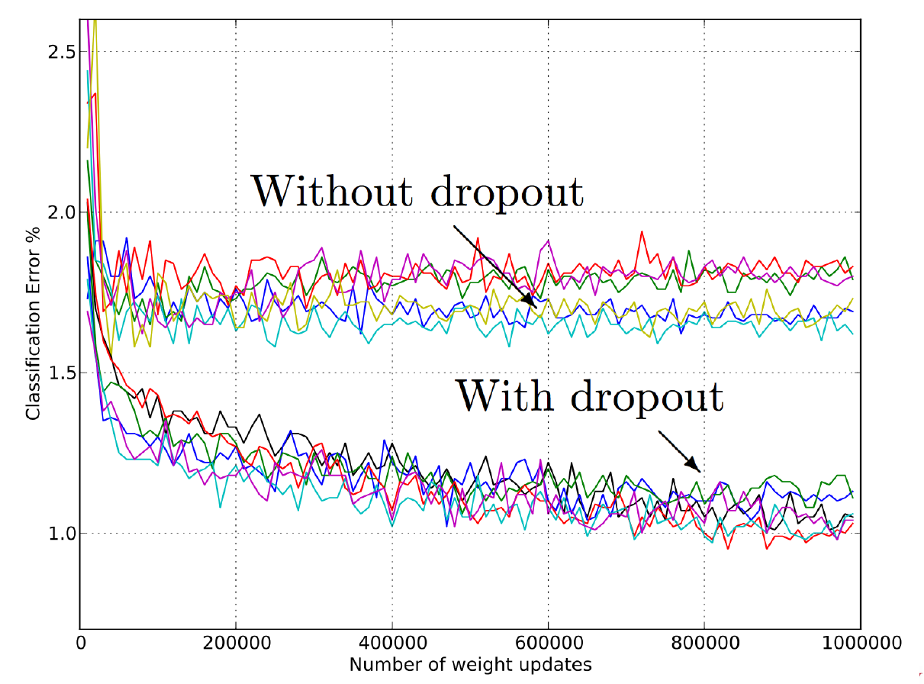
Dropout
Avoid the sensitive small changes in values impacting the whole network
Distribute the learning across the dimensions

Slide 9
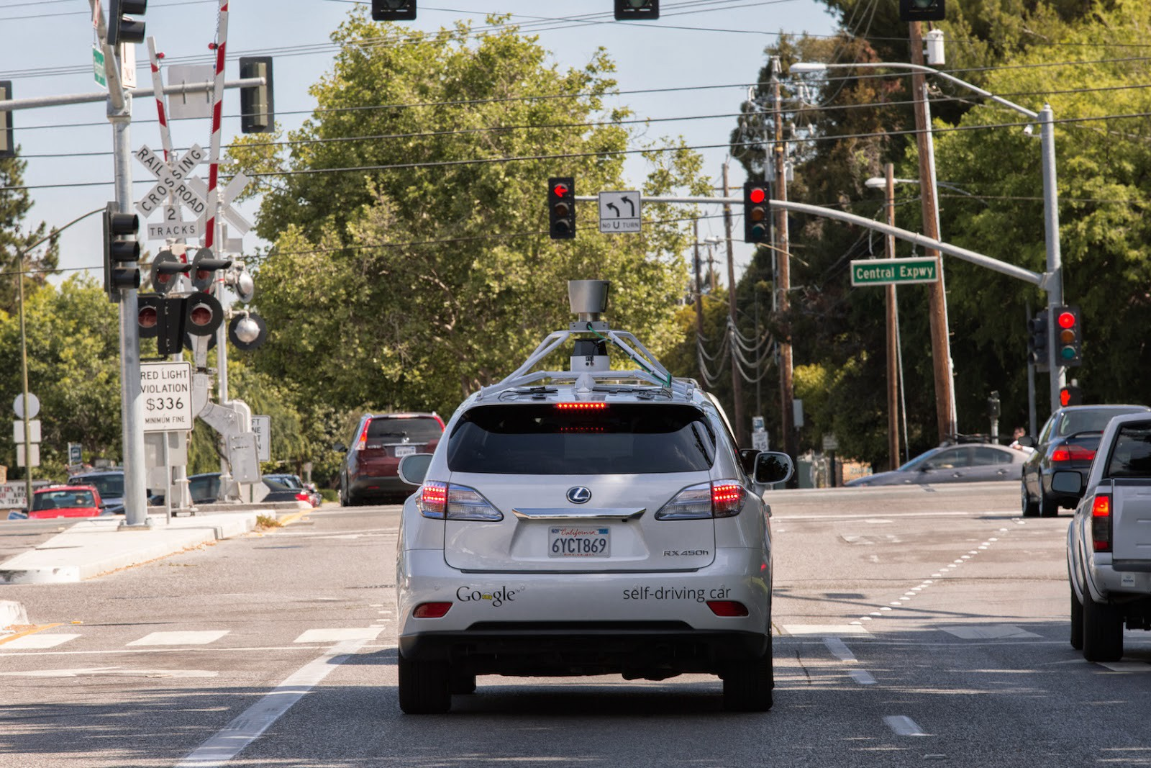
Application: Object Detection using Deep Learning
Input X
Output Ŷ
light
light
street
light
car
light
sign

Slide 10
Using CNNs with images
Because images have high resolution ~1000X~1000X3 (hXwXRGB)
Abdallah: Draw on the board the 64X64X3 to show what we need to compute
With convolutional neural networks, you can do:
Filters (to detect edges like vertical, horizontal, 45 degrees … etc)
Padding (to NOT loose the image boundary, example p=2)
Strides (to move the filters quickly, example s=3)
Max Pooling (take an area of the picture and pick the max value, some papers pick the average, but the majority pick the max)
What do these operations do
Object Detection: Sliding window, R-CNN, YOLO algorithm
YOLO inspired by GoogLeNet “Inception” model paper here

Slide 11
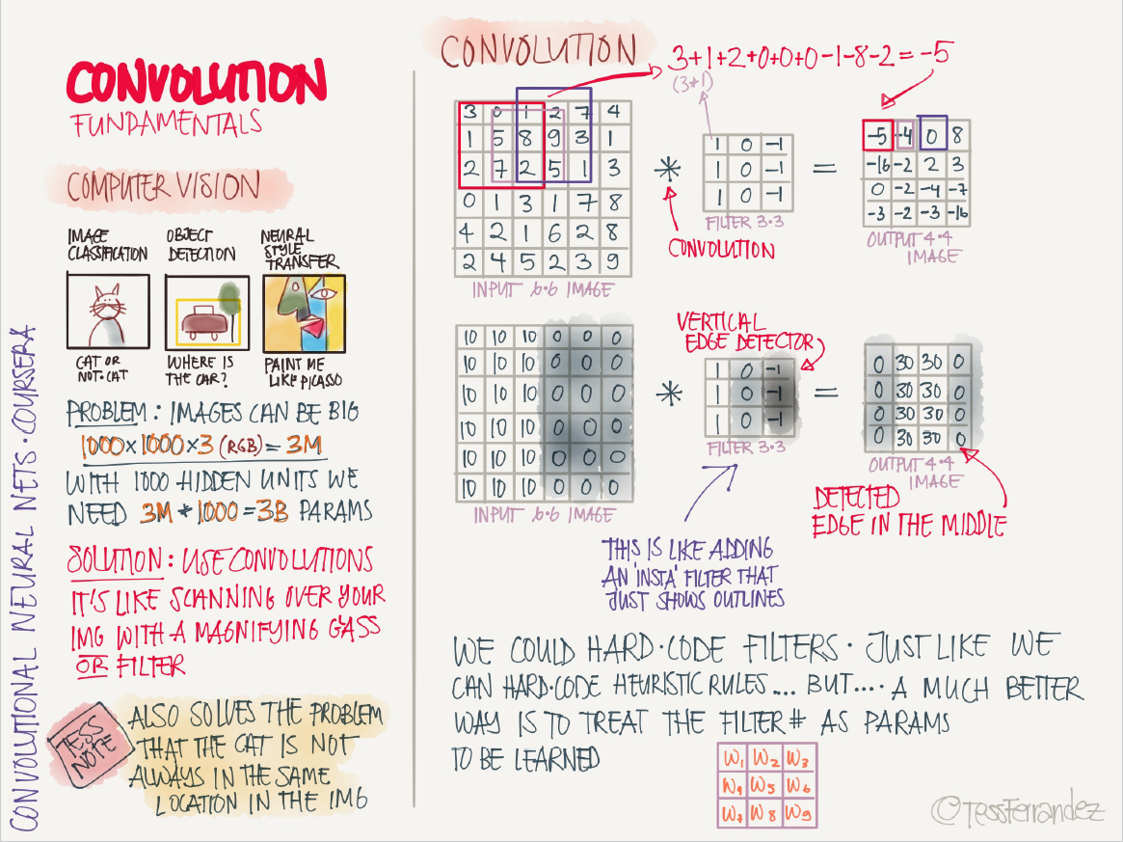

Slide 12
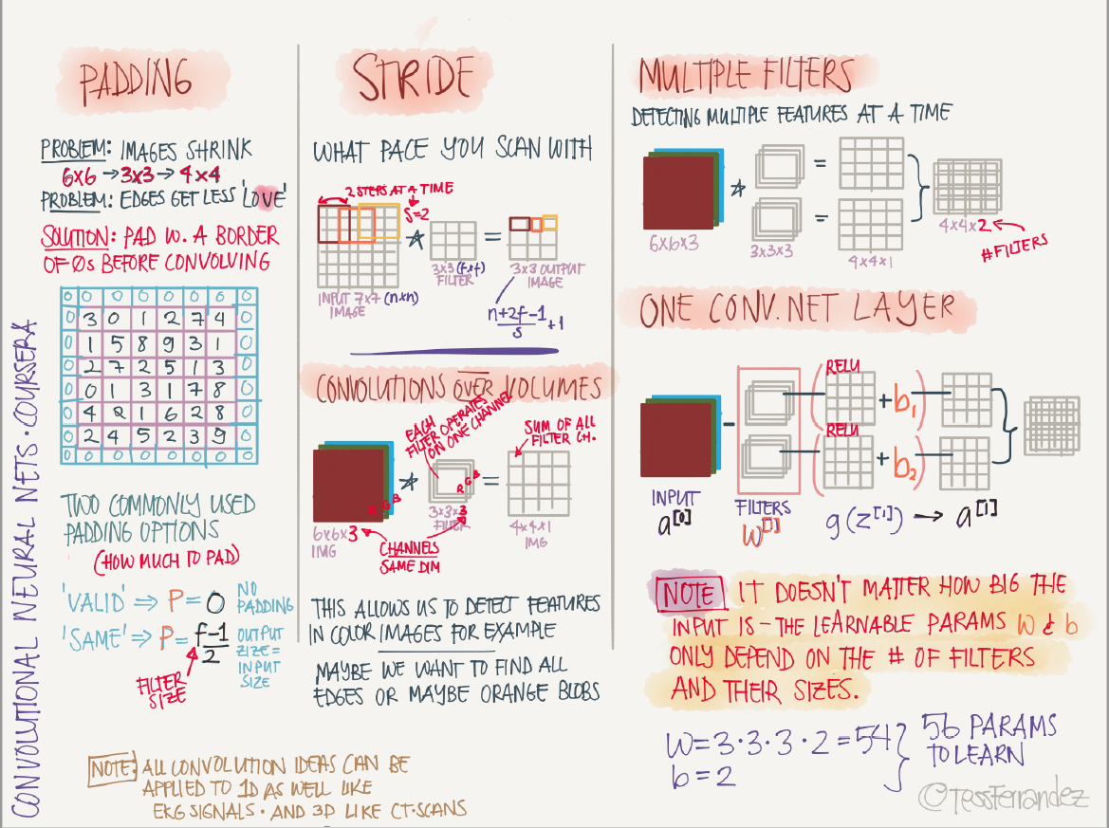

Slide 13
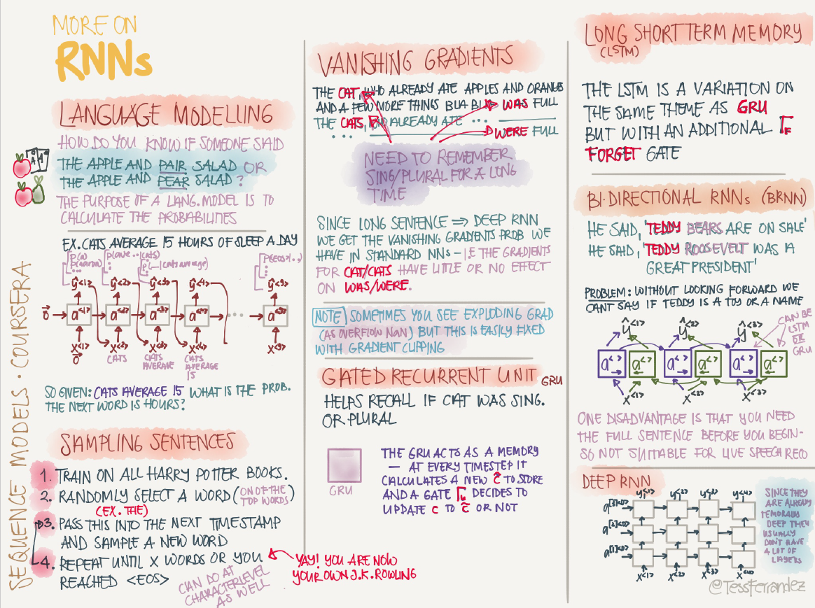

Slide 14
YOLO: You Only Look Once
A single CNN simultaneously predicts multiple bounding boxes probabilities
Input -> 24 convolutional layers -> 2 FC -> Output
Probability of detecting an object, then identifying its class
Bounding boxes (example: vertical for people & horizontal for cars)
Draw the output vector of pc and bx,by,bh,bw, …. bn c1,c2…cn
Use non max suppression to discard all boxes with p<threshold
For the remaining boxes, pick the largest p and discard remaining box with IoU>0.5
Looks at predicting objects as a regression problem with a probability p

Slide 15
YOLO: You Only Look Once
Steps: Resize, Run CNN, Threshold results
The Output Layer
Divide the image into a grid of SXS (S=7)
Each grid cell predicts B bounding boxes simultaneously (B=2)
There are C classes in the training dataset (C=20)
Output tensor dimensions are SXSX(B*5 + C) = 7X7X30
If the center of the object is in a grid cell, then that grid cell is responsible for detecting the object
For the final layer:
Width, height, and box coordinates are normalized
Relu activation function
Optimize use SSE

Slide 16
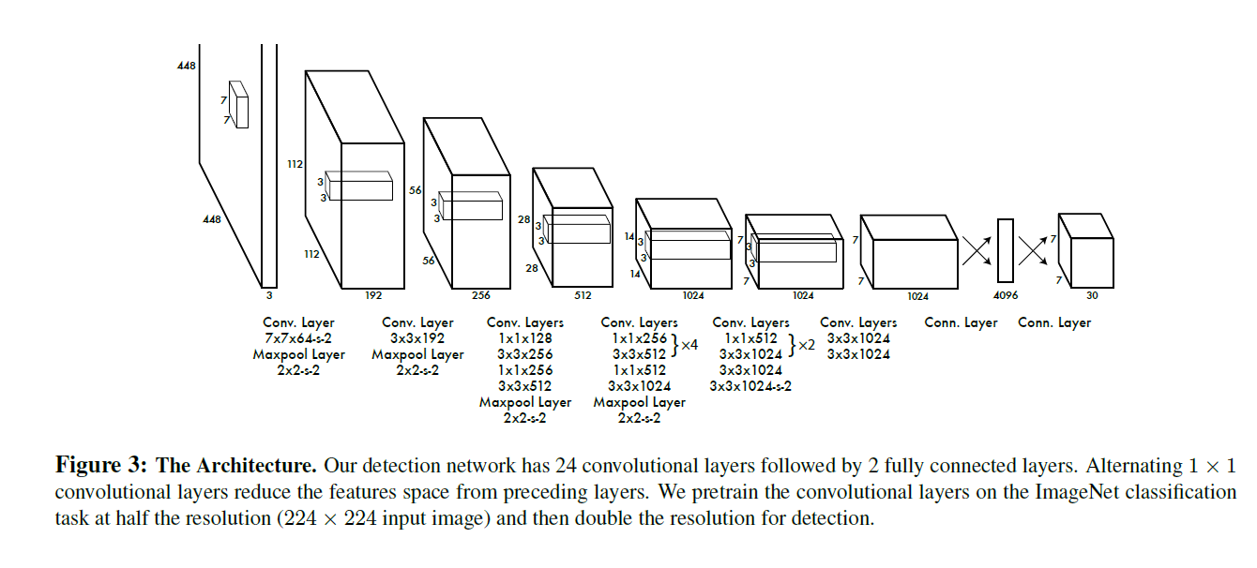

Slide 17
Move to unstructured data presentation

Slide 18
Questions?

Slide 19
Thank you! ☺

